Slide 1
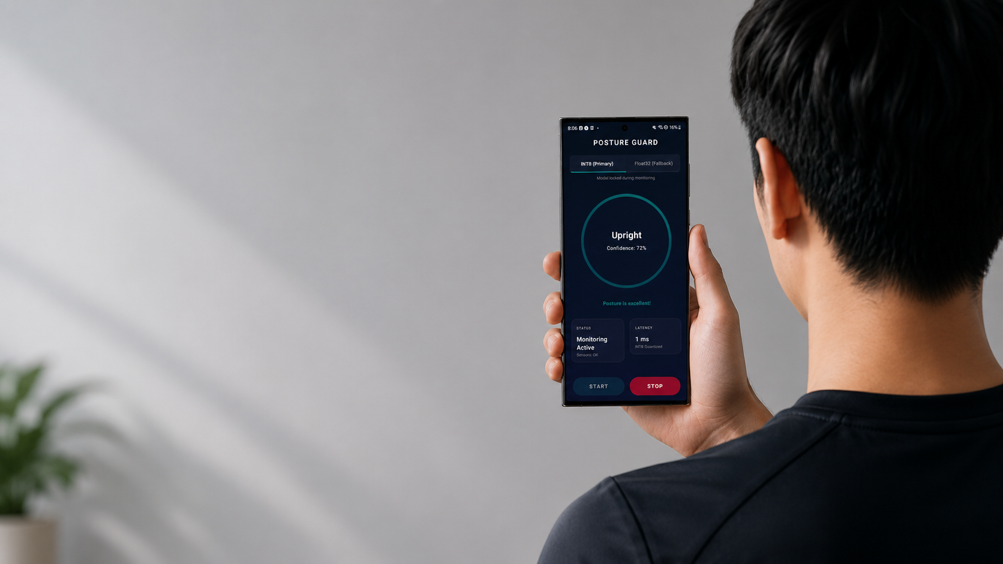

Smartphone IMU-Based
Real-Time
Posture Correction
Mobile Computing and Its Application
Mini Project
Seoul National University
Spring 2026
Presented by
HyunJong Park

Slide 2


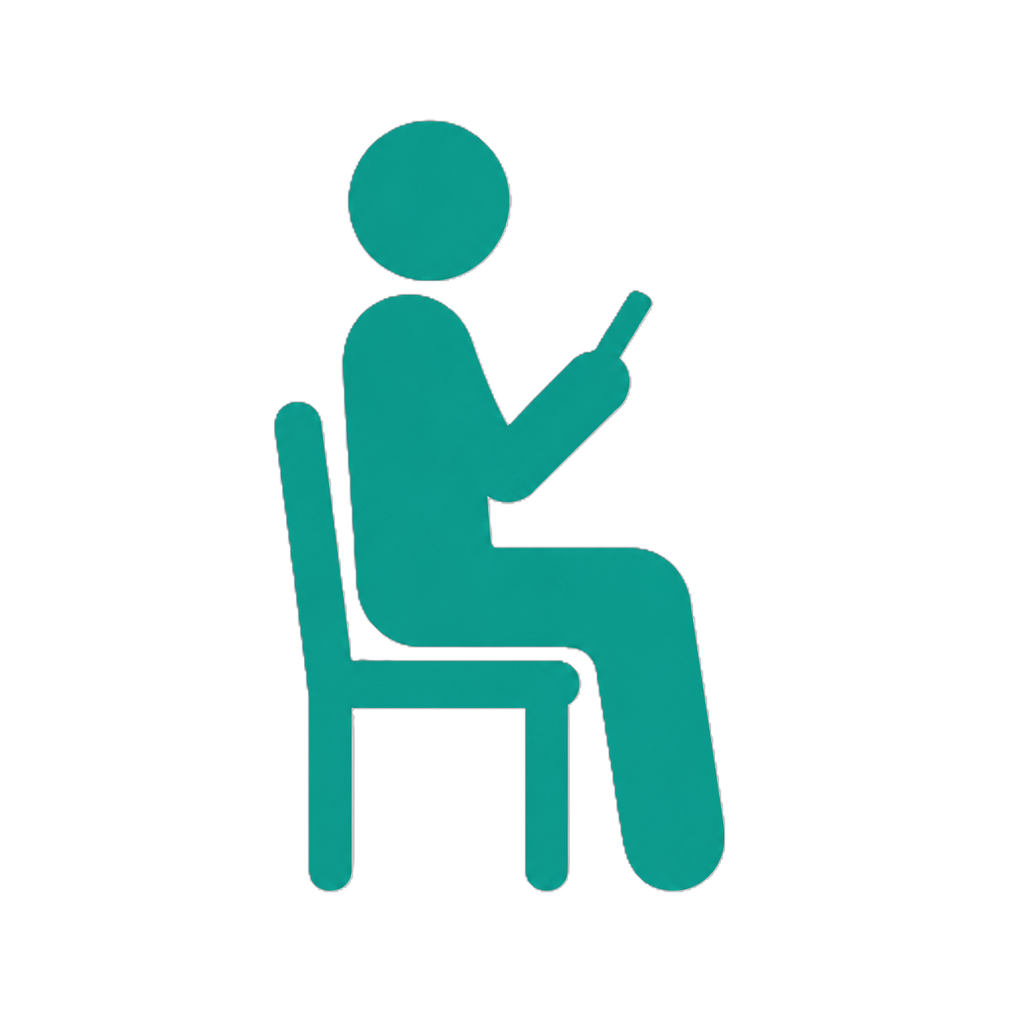
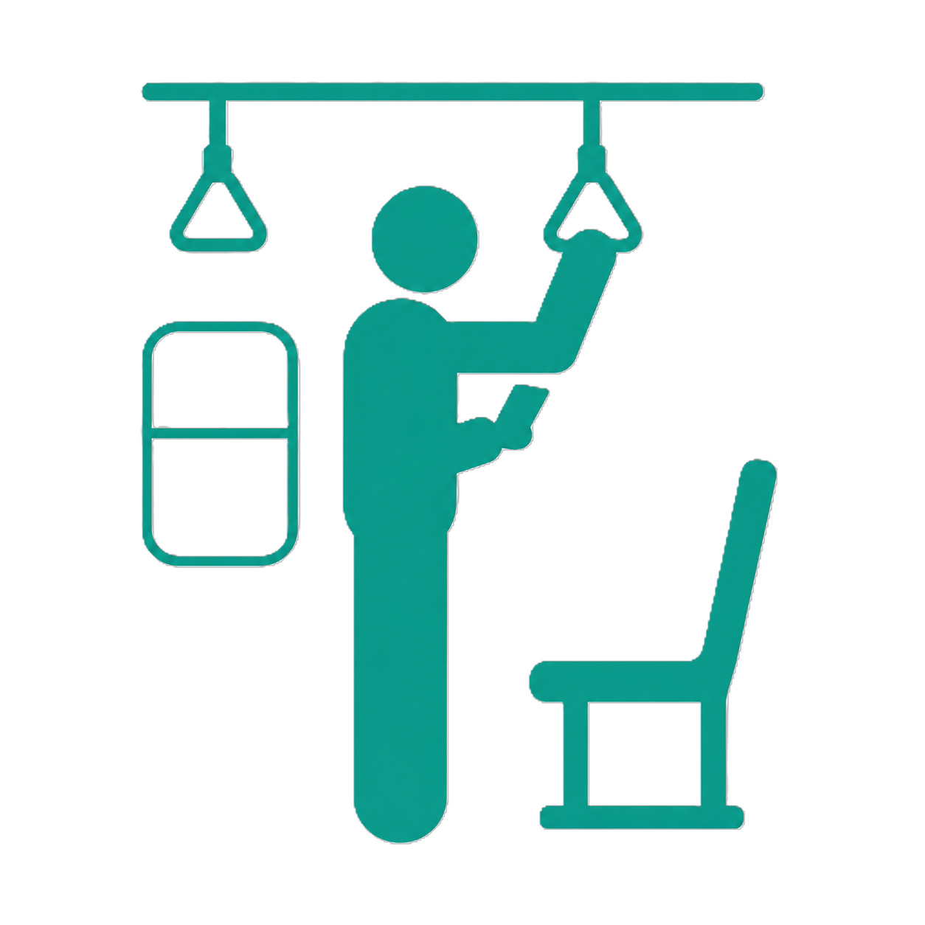
Goal & Usage Scenario
Detect poor neck posture during smartphone use
Usage Scenario
Problem
Goal
Standing
Users often maintain poor neck posture when using smartphones, which puts strain on the neck and can lead to neck pain and forward head posture.
Develop a lightweight, real-time posture correction system using only built-in smartphone IMU sensors (accelerometer & gyroscope) as an everyday posture-awareness assistant.
Sitting
Commuting

Slide 3
Key Idea
Robust Posture Classification with Temporal Filtering
Sense
Train
Infer
Feedback
 | t1 | t2 | t3 | avg
● | 0.60 | 0.40 | 0.55 | 0.52
● | 0.30 | 0.50 | 0.10 | 0.38
● | 0.10 | 0.10 | 0.10 | 0.10
6-axis IMU input
50 Hz sampling
Ring-buffered sensor stream
Input: 100 × 6 IMU window
(2 sec @ 50 Hz)
Lightweight 1D-CNN
Classes: Upright,
Mild Forward Flexion
Severe Looking-Down
Smooth prediction
probabilities
3-result moving average
Reduces transient
misclassification
8-sec sustained
poor-posture check
Vibration +
notification alert
Avoids immediate
false alarms

Slide 4
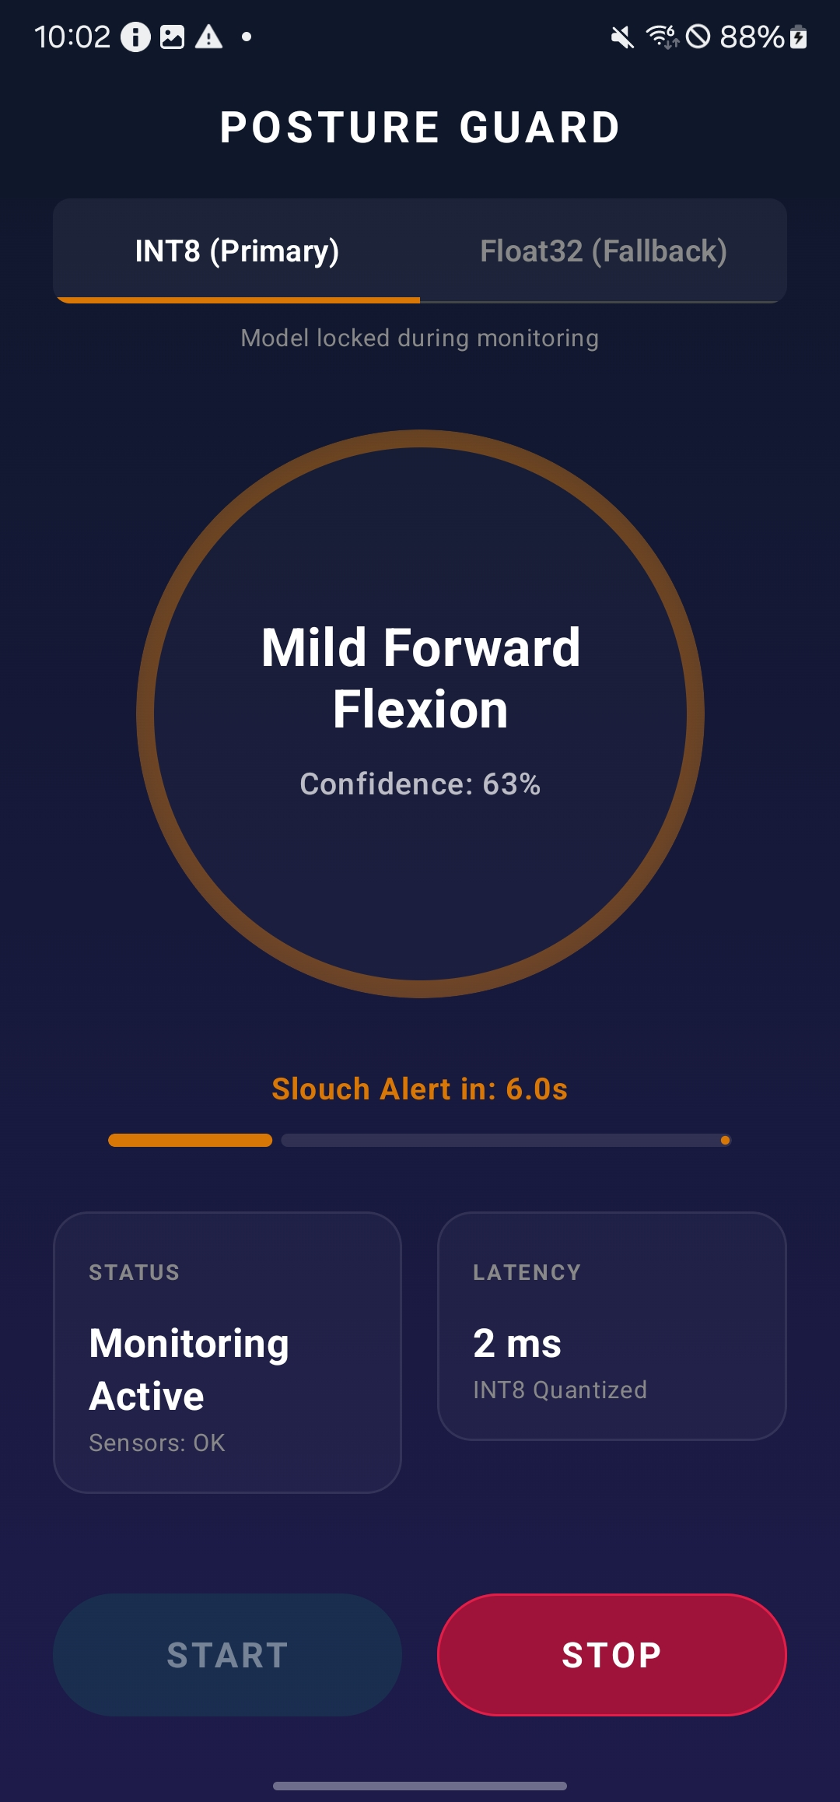
App Functionality Description
Posture Correction App – Screen Explanation
1. Model selection
Before starting monitoring, you can choose between INT8(default) or FP32(fallback)
1
2. Posture classification
Shows prediction for current posture (Upright, Mild Forward Flexion, and Severe Looking Down. )
Shows confidence for each state.
2
3. Countdown Bar
Shows countdown progress for persistent bad posture.
4. Monitoring status
Shows monitoring status: Stopped or Active
3
4
5
5. Latency
Shows inference latency of a model
6. Start/Stop monitoring
Button to start or stop monitoring
6

Slide 5
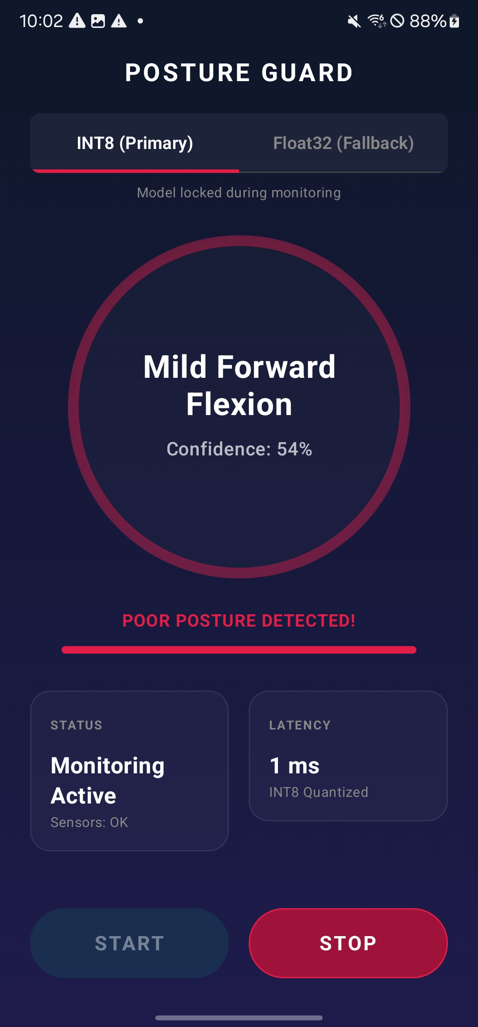
App Functionality Description
Posture Correction App – Practical Features
Alert Rule
If bad posture continues for 8 seconds, the app sends a notification and vibration alert
Foreground Service
Runs a background service to track posture even when using other apps.
Adaptive Vibration Feedback
Vibration intensity and frequency vary depending on posture severity
Screen-State Lifecycle Awareness
Automatically pauses sensor sampling when the screen turns off and resumes on screen unlock to save battery.

Slide 6
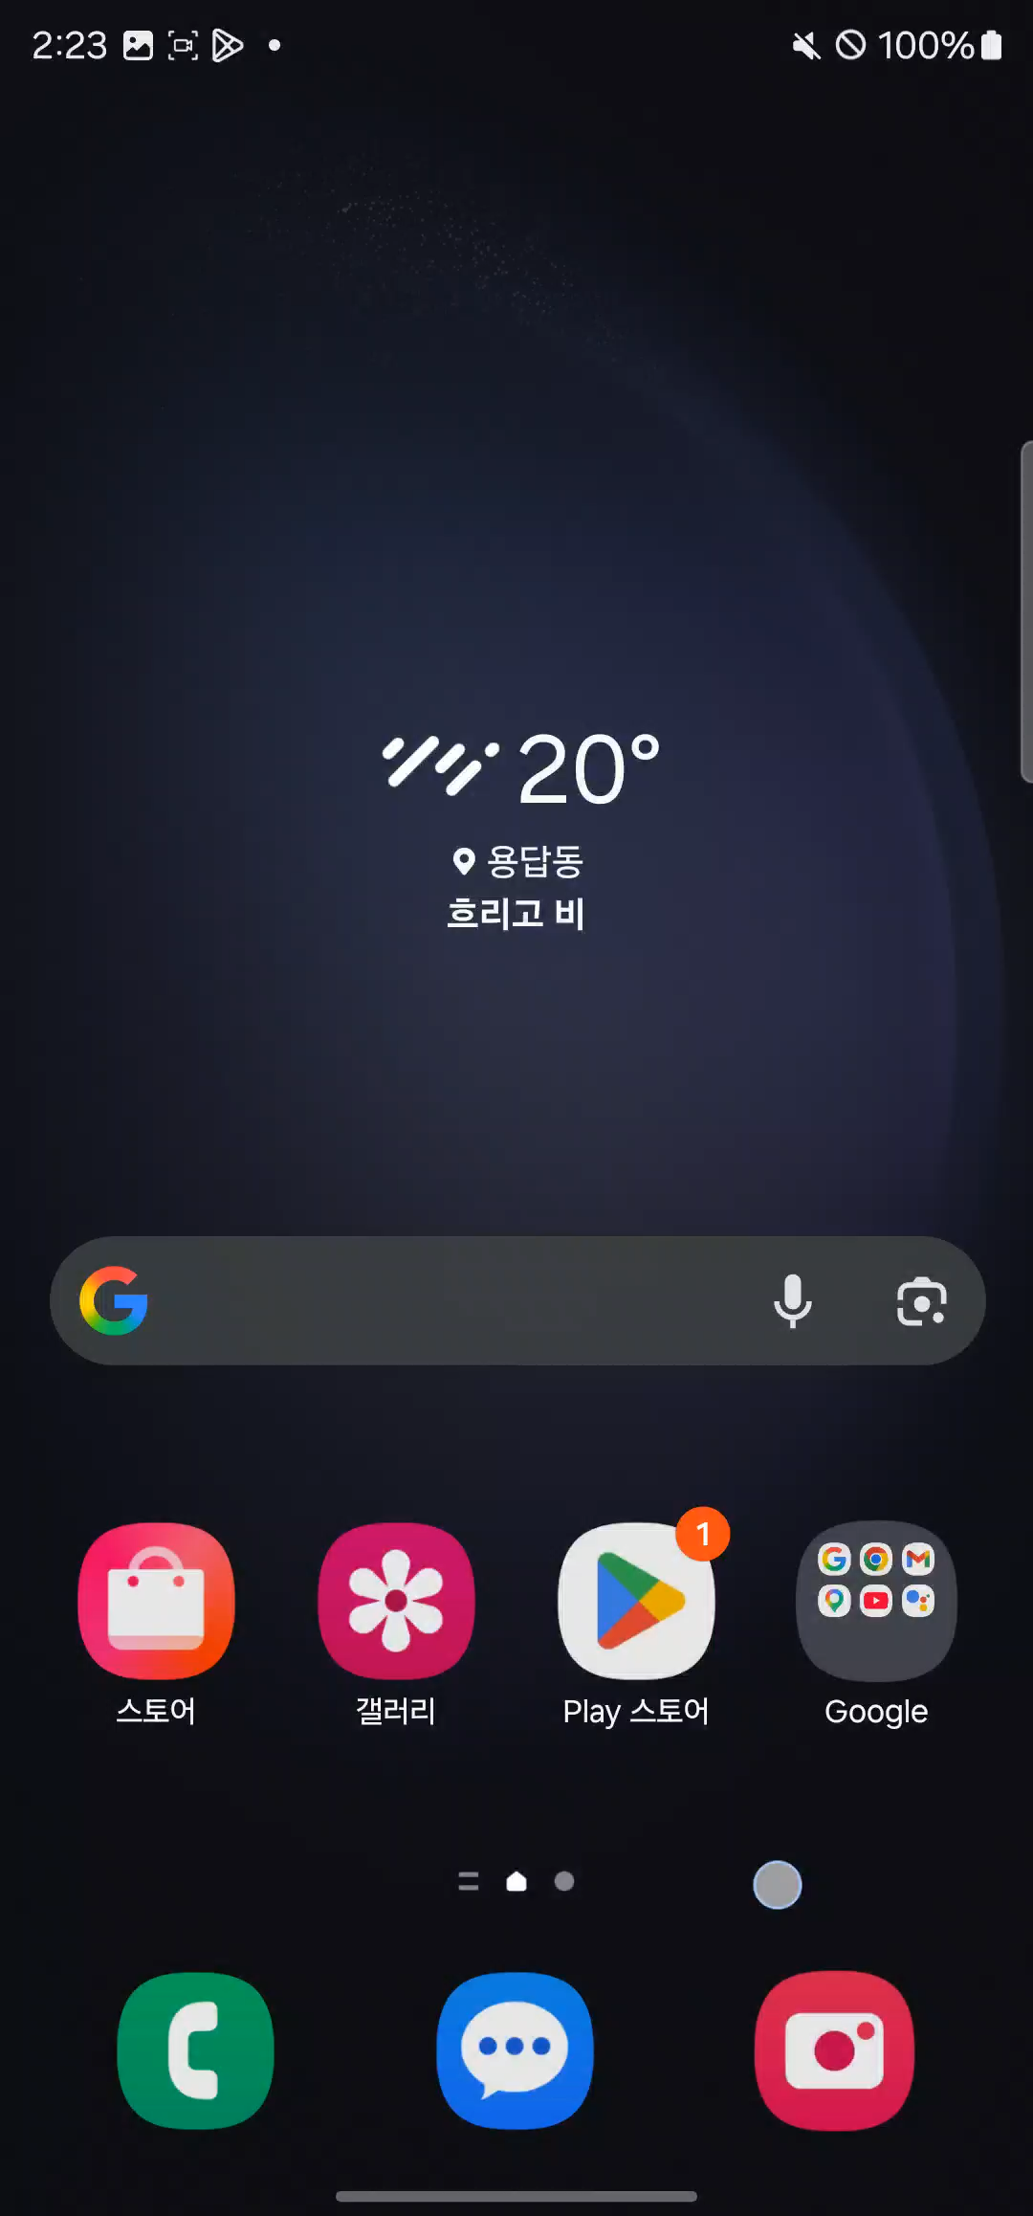

Slide 7
Comparison of Before/After Optimization
Improving Accuracy and Latency
Noisy Boundary Filtering
Model Quantization
Metric | Before Filtering | After Filtering
Test Accuracy | 90.72% | 92.90%
Macro F1 | 90.68% | 92.88%
Model | FP32 TFLite | INT8 TFLite
Size | 190 KB | 65KB
Latency | 0.1485ms | 0.1045ms
Before (Raw Windows): 90.72% Accuracy, 90.68% Macro-F1. Slouching detection suffered from transitional noise.
After (0.25s / 12-row margin removed): 92.90% Accuracy (+2.18%) and 92.88% Macro-F1 (+2.20%).
Model Size: Achieved a ~66% size reduction for resource-constrained environments.
Inference Latency: On invoke-only latency, the quantized INT8 model was 29.6% faster than the FP32 model on a Samsung Galaxy S23 Ultra.

Slide 8
Project Timeline & Contribution
Full pipeline: collection to real-time inference
Handled the entire pipeline independently, from data collection to app implementation
Phase
1
Tooling & Data Collection
Developed IMUDataCollectorApp for Android
Collected 16 separate labeled CSV sessions (posture_session_*.csv) under various contexts
Phase
2
Preprocessing & Training
Implemented preprocessing pipeline (50 Hz resampling, segmentation, transition margin trimming).
Performed cross-session test split validation
Phase
3
On-Device Integration
Developed the real-time posture monitoring App
Integrated TFlite inference
Phase 4
Polish & Wrap-Up
Polished minor features for practicality
Prepared final demonstration materials.

Slide 9
Thank You
https://github.com/13oris/PostureDetection

Slide 10
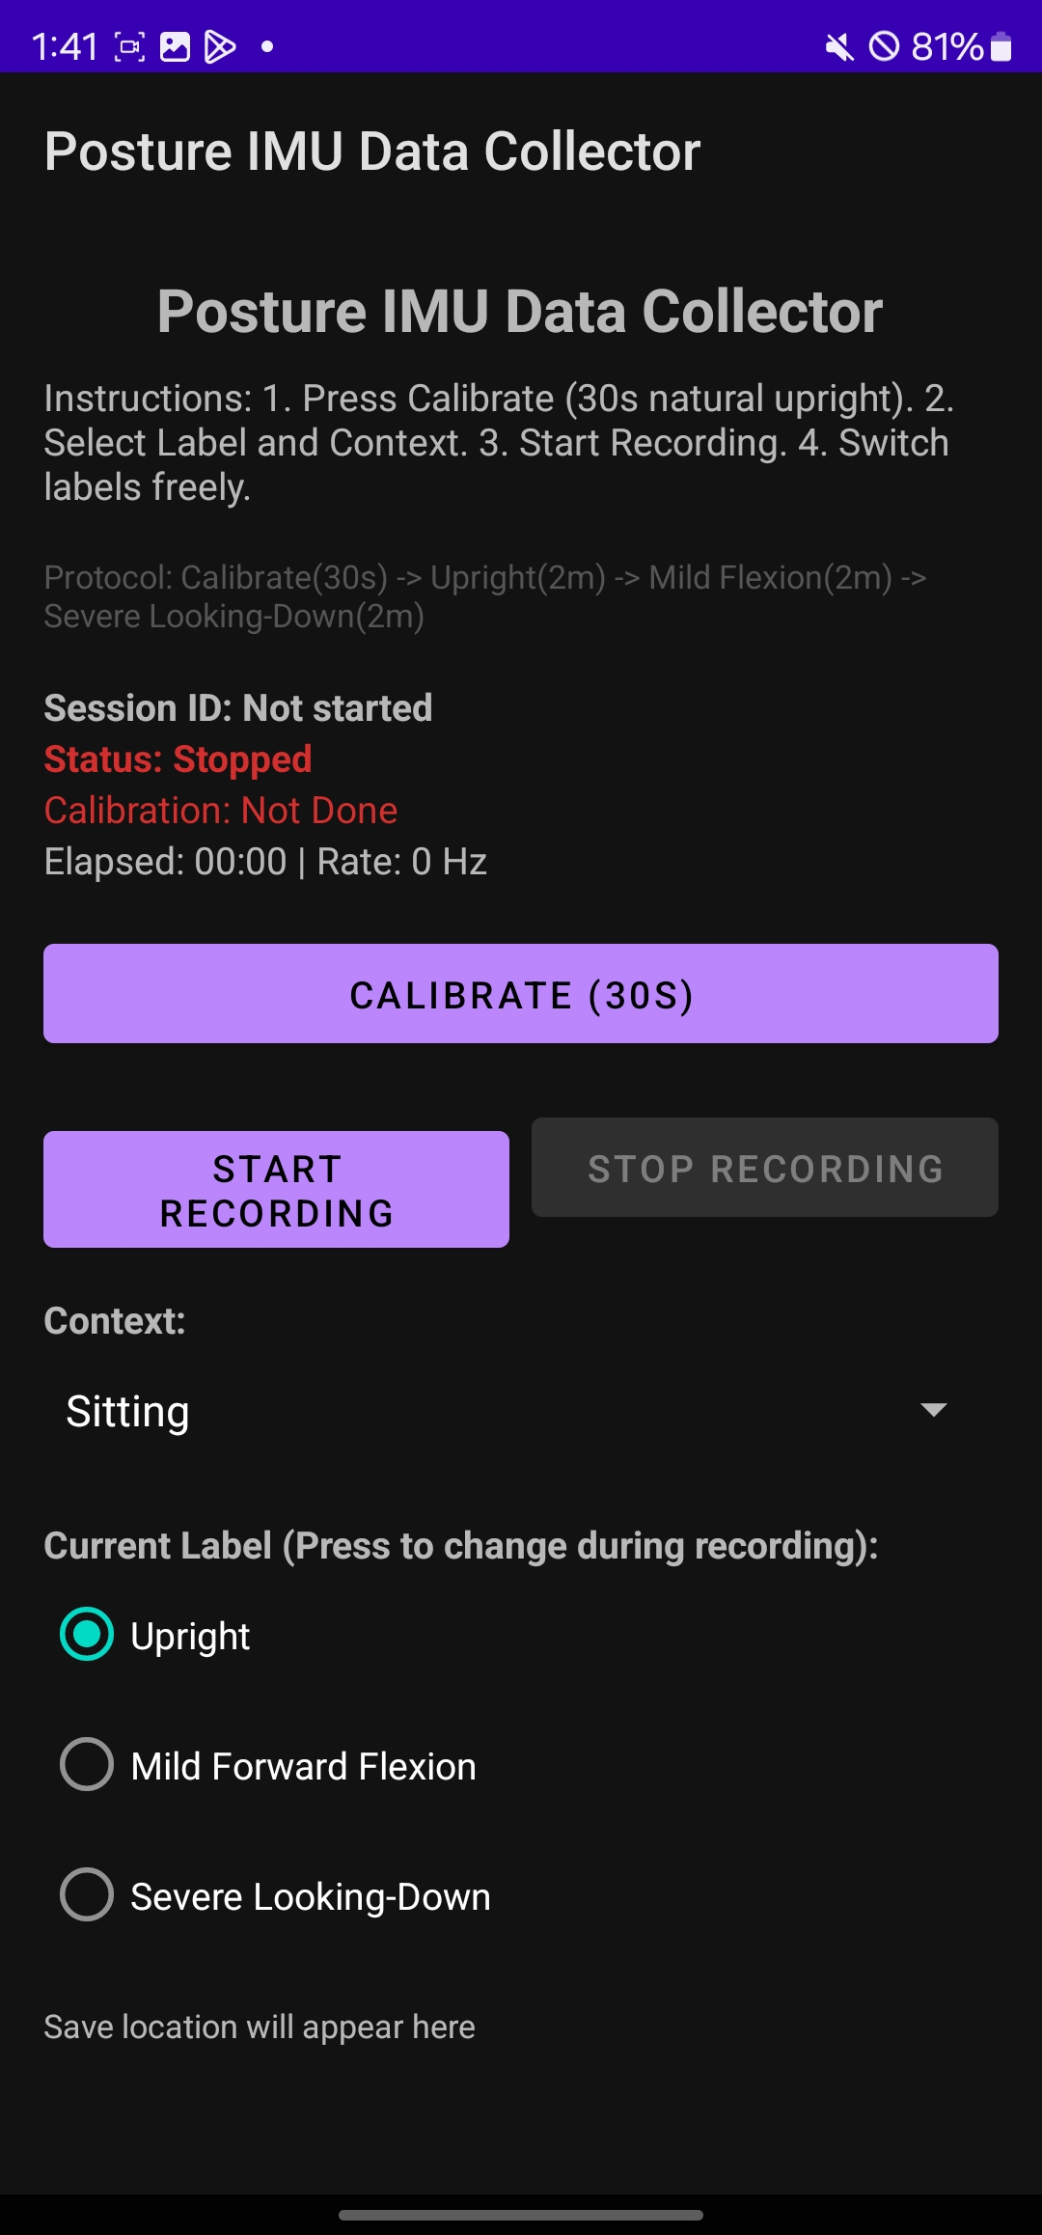
App Functionality Description
IMU Data Collector App
1. Status
Shows the Session ID, Status of data collecting, Calibration status, and time elapsed for data collection
2. Calibration Button
Calibrates user’s natural upright position for 30 seconds
1
2
3. Start/Stop Button
Starts or stops data collecting
3
4
4. Context Selector
You can select three contexts(Standing, Sitting, Commuting) for data collecting
5
5. Label Selector
You can manually select 3 labels(Upright, Mild Forward Flexion, Severe Looking Down)

